Slide 1
1
Security Systems
Het Patel
Group 1

Slide 2

Raise a voice on crimes and thefts.

Slide 3

How to prevent these ?
This is what reflects in our project
THEFT
ASSAULT
Kidnapping & Abduction
MURDERS
PROPERTY DAMAGE
RAPE
Dowry Deaths
ROBBERY

Slide 4

What does our project contain ?
helps find the possible age group to target with the awareness drives, the frequency of different crimes.
in-depth analysis of different crimes and thefts
01
02
03
04
Analysing the crime patterns over the previous years
evaluate the effectiveness of the current security measures in the country based on frequency of crimes.

Slide 5





Who would benefitted from this project ?
Police
Various Crime Agencies
Victims
Country and the people
The
knowledge gained from these then can be given to the police to organise effective measures
The information given the various crime agencies to help them take better decisions regarding prevention of crimes against women in India
The Government can now focus on other issues . Women also can play greater role in the development as they are not suppressed more
Proactive policing can help stop crime before it happens.

Slide 6

Explanation of Project Idea :
The model developed by our team focuses on the analysis of crimes & thefts in different parts of the country and possible contributing factors.
Collection of data
Analysis
Visualisation
Data will be collected from reliable websites and gathered into a useful dataset
Analysis includes trends of violence , which area is most prone to , which age group tends to commit lot of crimes.
Analysis can be presented through visualisations which stress the relevance of this project in current times
Prediction
Suggestions
Publication of Report
Prediction of frequency of crimes in a particular state and to be targeted age group
Make recommendations based on the trends observed , explain about what kind of measures are actually needed
This journey of realisations can only be completed by production of a reliable report

Slide 7

Sources of Data :
Datasets for contributing factors:
https://Kaggle.com

Slide 8
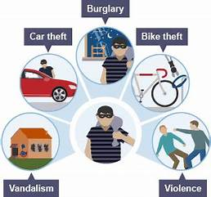
Crimes
Robbery
Robbery is a type of theft that involves taking someone else's property by force, threat, or intimidation
Burglary
Burglary is a type of theft that involves illegally entering a building, such as a home, business, or other structure, with the intent to commit a crime.
Rape
Rape is a form of sexual assault in which a person is forced to engage in sexual relations against his or her will or without having given consent.
Theft
Theft is the act of taking someone else's property without their consent, with the intent of permanently depriving them of the property. It can involve physical property, such as money, goods, or personal belongings, or non-physical property, such as intellectual property or trade secrets
Murder
Murder is the unlawful killing of another human being with malice aforethought. Malice aforethought is the intent to cause harm or death to another person, or acting in a way that is so reckless as to show a complete disregard for human life.

Slide 9
Tools used :
Python
OPEN BI
NumPy, Pandas, Matplotlib.
Line chart , Area chart,Ribbon chart Horizontal bars, Stacked bars, Side by side bars, map.
PyCharm IDE
To run python code

Slide 10



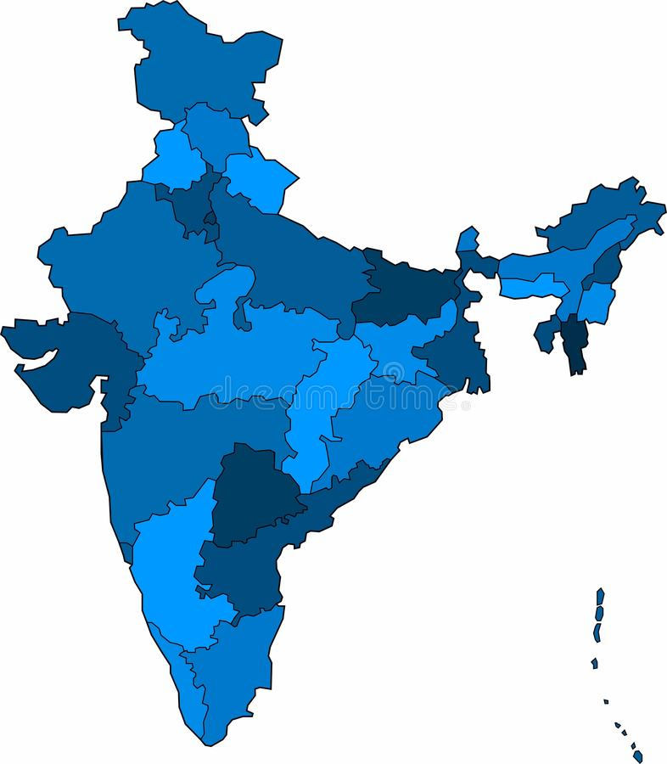
Data Analysis and Findings
--1.dataset on crimes over the years 2001-2015
Most frequent crime over all the years.
Rape has been increasing in an irregular trend.
Murders of woman's are increased.
Burglary and robbery in increased.
Mostly home thefts are increasing.
Crime which is maximum
Theft is increased including home theft ,vehicle theft ,shop theft , out of vehicle theft
Area wise
Crime in Rural areas are more

Slide 11

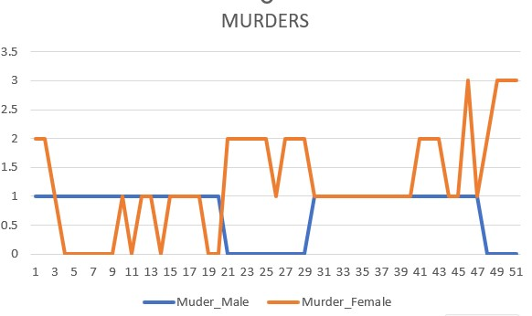
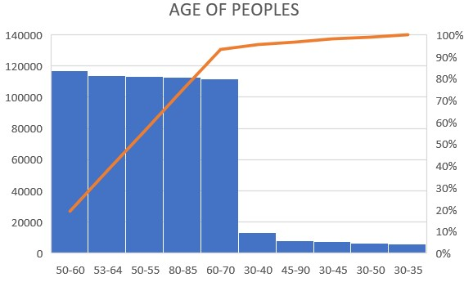
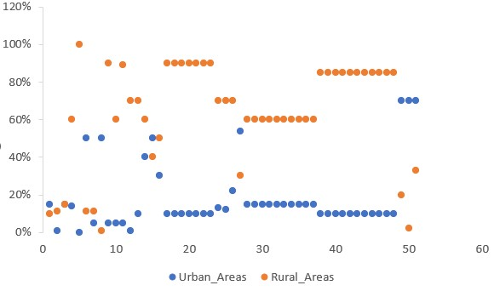
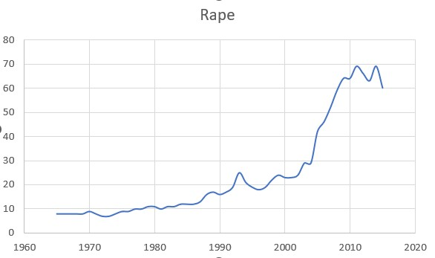
COMPARISON CHARTS
Notes:
Photo by Campaign Creators on Unsplashed

Slide 12
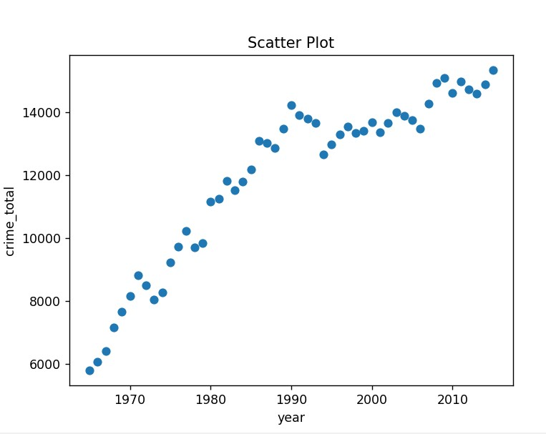

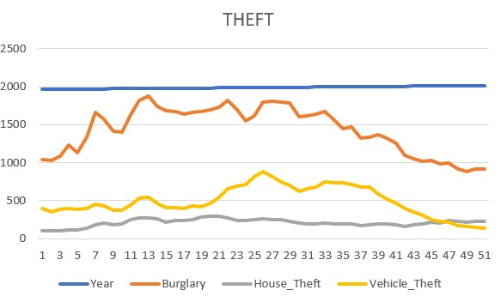
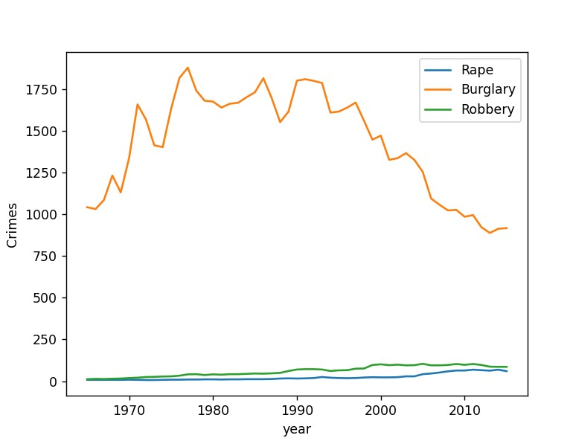
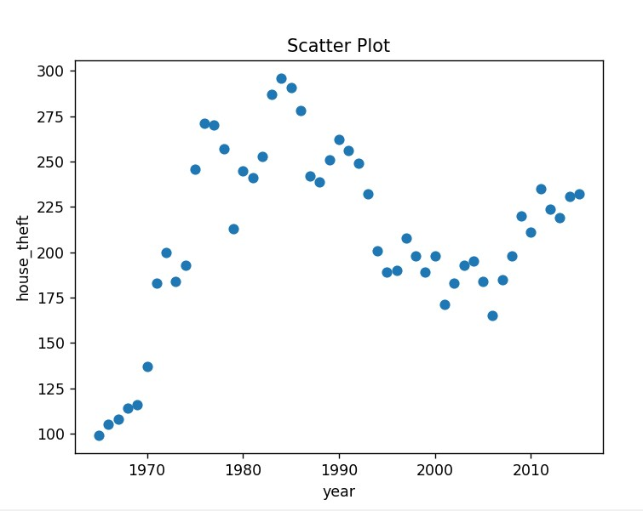

Slide 13

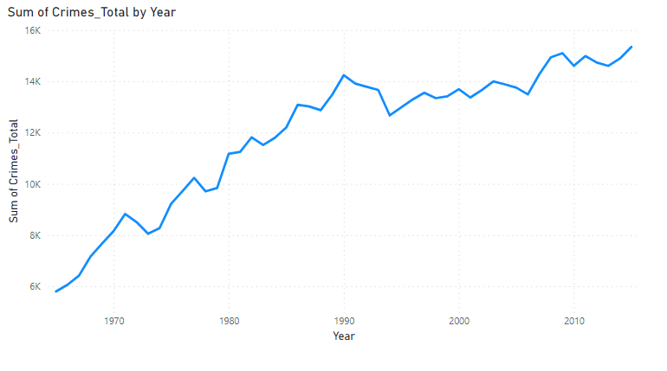
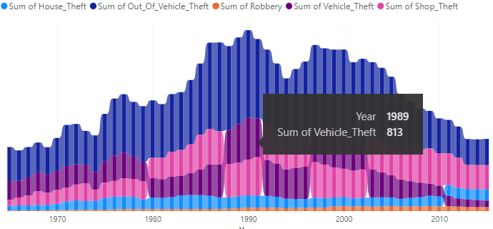

Slide 14

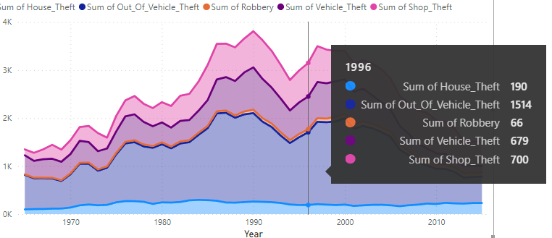
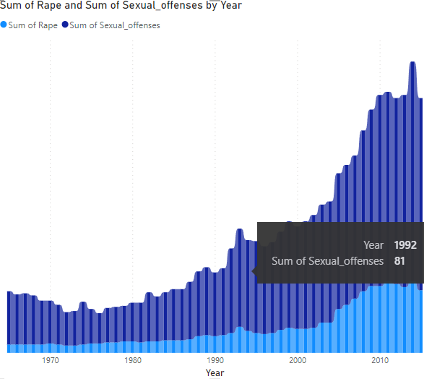

Slide 15

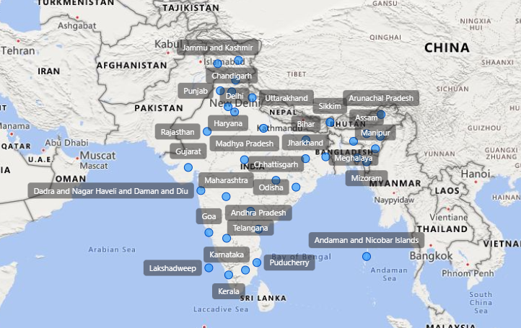

Slide 16

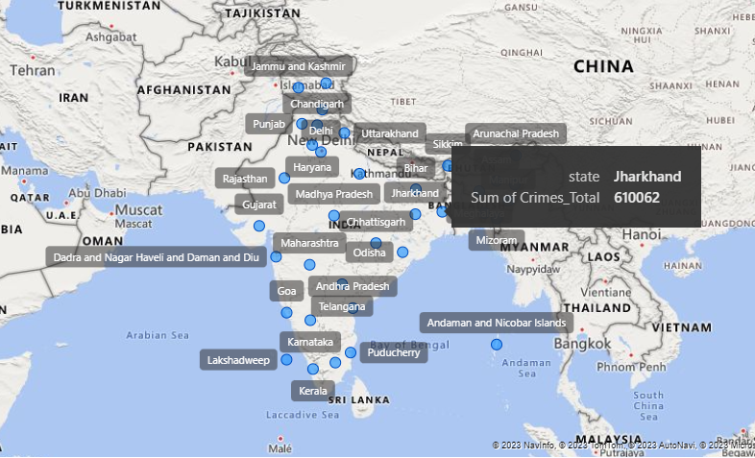

Slide 17

Actual versus predicted values
crime | Actual | predicted_2016
RAPE | 2086 | 2076
MURDER | 1302 | 539
THEFT | 9912 | 8883
ROBBERY AND BULGARY | 6002 | 5157
Your Heading Text Here
Your Heading Text Here
This is dummy text. This text can be replaced with your own text.
This is dummy text. This text can be replaced with your own text.
Your Heading Text Here
Your Heading Text Here
This is dummy text. This text can be replaced with your own text.
This is dummy text. This text can be replaced with your own text.

Slide 18

Thank you
Cone

